Slide 1
Recap lecture 37
New format for FAs, input TAPE, START, ACCEPT , REJECT, READ states Examples of New Format of FAs, PUSHDOWN STACK , PUSH and POP states, Example of PDA

Slide 2
START
a
∆
PUSH a
READ₁
b
b
a
∆
POP₂
POP₁
READ₂
b,
a,b
∆
∆
a
REJECT
ACCEPT
REJECT

Slide 3
Note: The process of running the string aaabbb can also be expressed in the following table
STATE
STACK
TAPE
START
∆ …
aaabbb∆ …
READ₁
∆ …
aaabbb∆ …
PUSH a
a∆ …
aaabbb∆ …
READ₁
a∆ …
aaabbb∆ …
PUSH a
aa∆ …
aaabbb∆ …
READ₁
aa∆ …
aaabbb∆ …
PUSH a
aaa∆ …
aaabbb∆ …
READ₁
aaa∆ …
aaabbb∆ …
POP₁
aa∆ …
aaabbb∆ …

Slide 4
Example contd. …
STATE
STACK
TAPE
READ₂
POP₁
READ₂
POP₁
aa∆ …
aaabbb∆ …
a∆ …
aaabbb∆ …
a∆ …
aaabbb∆ …
∆ …
aaabbb∆ …
READ₂
∆ …
aaabbb∆ …
POP₂
∆ …
aaabbb∆ …
ACCEPT
∆ …
aaabbb∆ …
It may be observed that the above PDA accepts the language {a^{n}b^{n} : n=0,1,2,3, …}.

Slide 5
Note
It may be noted that the TAPE alphabet Σ and STACK alphabet Γ, may be different in general and hence the PDA equivalent to that accepting {a^{n}b^{n}: n=0,1,2,3…} discussed above may be

Slide 6
START
a
∆
PUSH X
READ₁
b
b
∆
X
X
READ₂
POP₂
POP₁
∆
a
∆
REJECT
ACCEPT
Following is an example of PDA corresponding to an FA

Slide 7
Example
Consider the following FA corresponding to the EVEN-EVEN language
The corresponding PDA will be
a
±
a
b
b
b
b
a
a

Slide 8




Example continued …
ACCEPT
REJECT
$$Δ$$
a
$$Δ$$
READ₁
READ₂
START
a
b
b
b
a
b
READ₄
READ₃
$$Δ$$
a
$$Δ$$
REJECT
REJECT

Slide 9
Nondeterministic PDA
Like TGs and NFAs, if in a PDA there are more than one outgoing edges at READ or POP states with one label, then it creates nondeterminism and the PDA is called nondeterministic PDA.
In nondeterministic PDA no edge is labeled by string of terminals or nonterminals, like that can be observed in TGs. Also if there is no edge for any letter to be read from the TAPE, the machine crashes and the string is rejected.

Slide 10
Nondeterministic PDA continued …
In nondeterministic PDA a string may trace more than one paths. If there exists at least one path traced by a string leading to ACCEPT state, then the string is supposed to be accepted, otherwise rejected.
Following is an example of nondeterministic PDA

Slide 11
START
a
POP₁
a
a
b
a
PUSH a
READ₁
b
b
READ₂
POP₂
PUSH b
b
∆
∆
POP₃
∆
ACCEPT

Slide 12
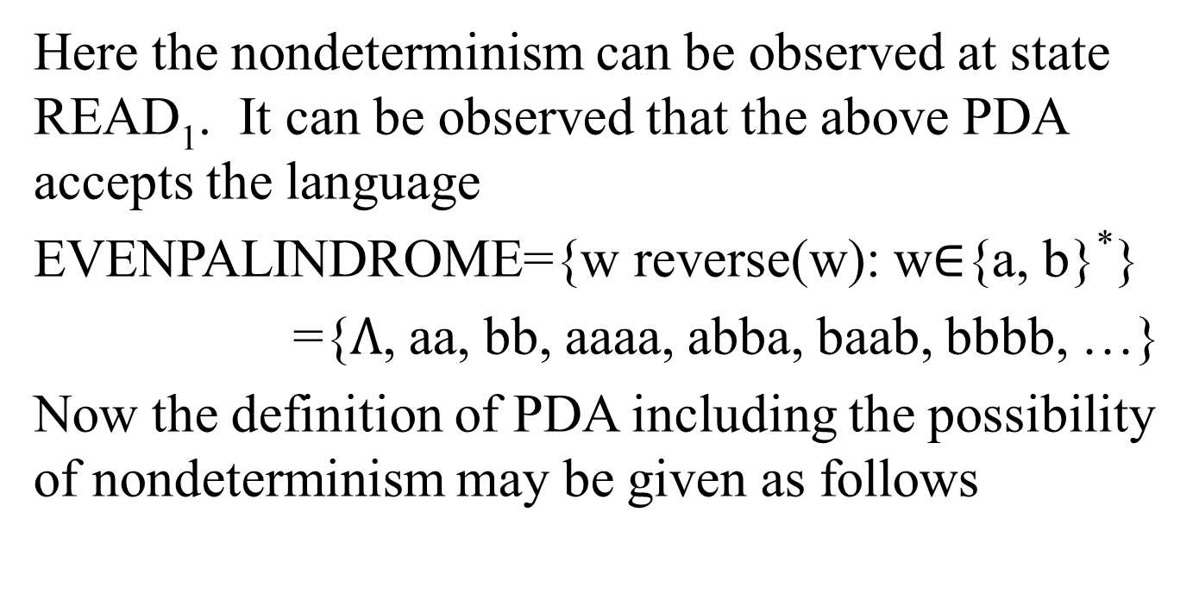
Nondeterministic PDA continued …
Here the nondeterminism can be observed at state READ₁. It can be observed that the above PDA accepts the language
EVENPALINDROME={w reverse(w): w$∈${a, b}*}
={$Λ$, aa, bb, aaaa, abba, baab, bbbb, …}
Now the definition of PDA including the possibility of nondeterminism may be given as follows

Slide 13
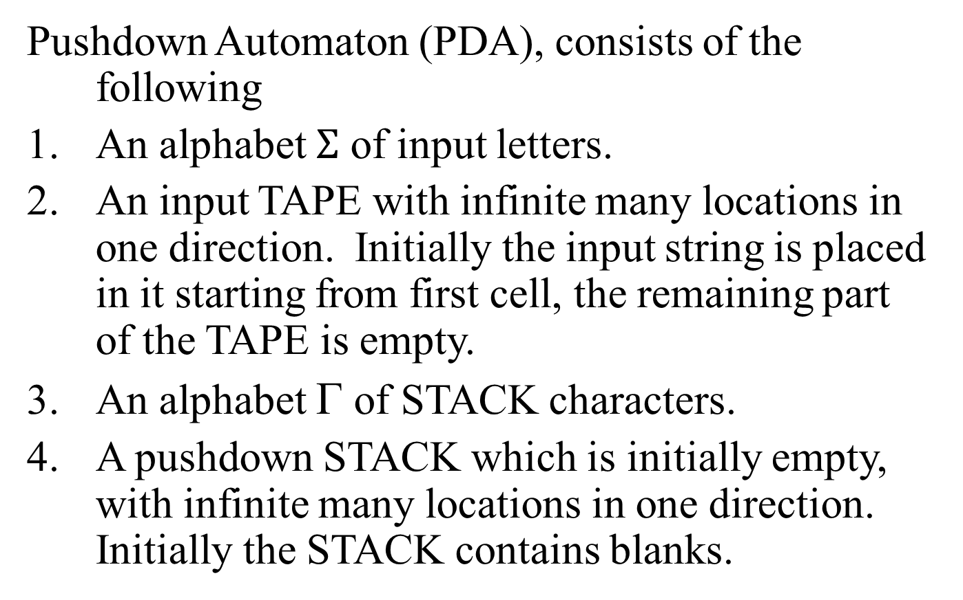
PUSHDOWN AUTOMATON (PDA)
Pushdown Automaton (PDA), consists of the following
An alphabet $Σ$ of input letters.
An input TAPE with infinite many locations in one direction. Initially the input string is placed in it starting from first cell, the remaining part of the TAPE is empty.
An alphabet Γ of STACK characters.
A pushdown STACK which is initially empty, with infinite many locations in one direction. Initially the STACK contains blanks.

Slide 14
PDA Continued ...
One START state with only one out-edge and no in-edge.
Two halt states i.e. ACCEPT and REJECT states, with in-edges and no out-edges.
A PUSH state that introduces characters onto the top of the STACK.
A POP state that reads the top character of the STACK, (may contain more than one out-edges with same label).

Slide 15
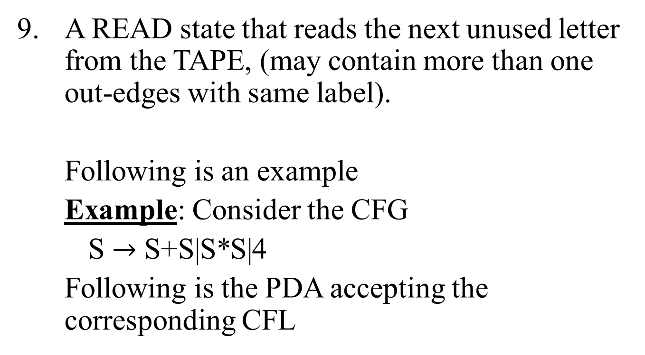
PDA Continued ...
A READ state that reads the next unused letter from the TAPE, (may contain more than one out-edges with same label).
Following is an example
Example: Consider the CFG
S $→$ S+S|S*S|4
Following is the PDA accepting the corresponding CFL

Slide 16
4
+
*
RD₁
RD₃
RD₂
AT
ST
+
∆
S
*
PH₁S
∆
PP
RD₄
S
S
NOTE:
ST stands for START
AT stands for ACCEPT
RT stands for REJECT
RD stands for READ
PH stands for PUSH
PP stands for POP
PH₂S
PH₅S
PH₃+
PH₆*
PH₄S
PH₇S

Slide 17
The string 4 + 4 * 4 traces the path shown in the following table
STATE
STACK
TAPE
START
∆
4+4*4
PUSH₁ S
S
4+4*4
POP
∆
4+4*4
PUSH₂ S
S
4+4*4
PUSH₃ +
+S
4+4*4
PUSH₄ S
S+S
4+4*4
POP
+S
4+4*4
READ₁
+S
+4*4
POP
S
+4*4

Slide 18
Example continued …
STATE
STACK
TAPE
READ₂
S
4*4
POP
∆
4*4
PUSH₅ S
S
4*4
PUSH₆ *
*S
4*4
PUSH₇ S
S*S
4*4
POP
*S
4*4
READ₁
*S
*4
POP
S
*4

Slide 19
Example continued …
STATE
STACK
TAPE
Following is a note
READ₃
S
4
POP
∆
4
READ₁
∆
∆
POP
∆
∆
READ₄
∆
∆
ACCEPT
∆
∆

Slide 20
Note
It may be noted that the letters are deleted from the TAPE instead of underlined.
It may also be noted that the choice of path at POP state can be determined by the left most deviation of the string belonging to the CFL.

Slide 21
Summing Up
Example of PDA with table for running a string, Equivalent PDA, PDA for EVEN EVEN Language. Non-Derterministic PDA, Example of Non-Derterministic PDA, Definition of PUSH DOWN Automata, Example of Non-Derterministic PDA.

